Slide 1

Benford’s Law in Crude Oil DataSet
COURSE : Mathematics for Computer Science – II
Instructor : Mr. Rishabh Bafna |
TEAM NAME : ALGOMINDS
TEAM MEMBERS : -
Himanshu Mishra - 2024-B-03092006A
Harsh Patel - 2024-B-09052008
Krish Modi - 2024-B-06062006A
Hirdyansh Kumar - 2024-B-24012006A

Slide 2


Understanding Benford’s Law
What is It?
Digit Frequency
A mathematical law predicting the frequency of leading digits in natural data.
The digit 1 appears most often, then 2, 3, … down to 9 in decreasing order.
Applications
Used for fraud detection, data validation, and identifying anomalies.

Slide 3
Crude Oil Dataset Overview
Dataset Content
Significance
Includes crude oil production, export, consumption, and pricing data.
Wide numeric range across multiple fields, ideal for Benford’s Law testing.
Includes multiple numeric fields with values across various magnitudes
Naturally occurring data — not manually manipulated — aligns with real-world numeric patterns
Numeric values range from thousands to billions, ensuring scale diversity
Enables testing of first-digit frequency distribution across diverse quantities
Contains fields like:
Relevance to economics and global energy trends gives the project both mathematical and real-world significance
Barrels produced (per day/year)
Pricing per barrel (in USD)
Can reveal anomalies, inconsistencies, or errors in economic reporting through deviation from expected distribution
Volume of reserves (in million barrels)
Import/export volume across trade partners

Slide 4





Methodology Overview
Digit Extraction
Collected first significant digits from all numeric fields.
Frequency Counting
Calculated occurrence of digits 1 through 9.
Comparison
Compared observed data distribution to expected Benford distribution.
Visualization
Created visual aids for clear interpretation of results.

Slide 5

Observed vs Expected Digit Frequencies
Digit
Expected (%)
Observed (%)
1
30.1
29.8
2
17.6
17.4
3
12.5
12.3
4
9.7
10.0
5
7.9
8.1
6
6.7
6.5
7
5.8
6.0
8
5.1
5.2
9
4.6
4.7
Digit 1 dominates as predicted; subsequent digits decline steadily.

Slide 6
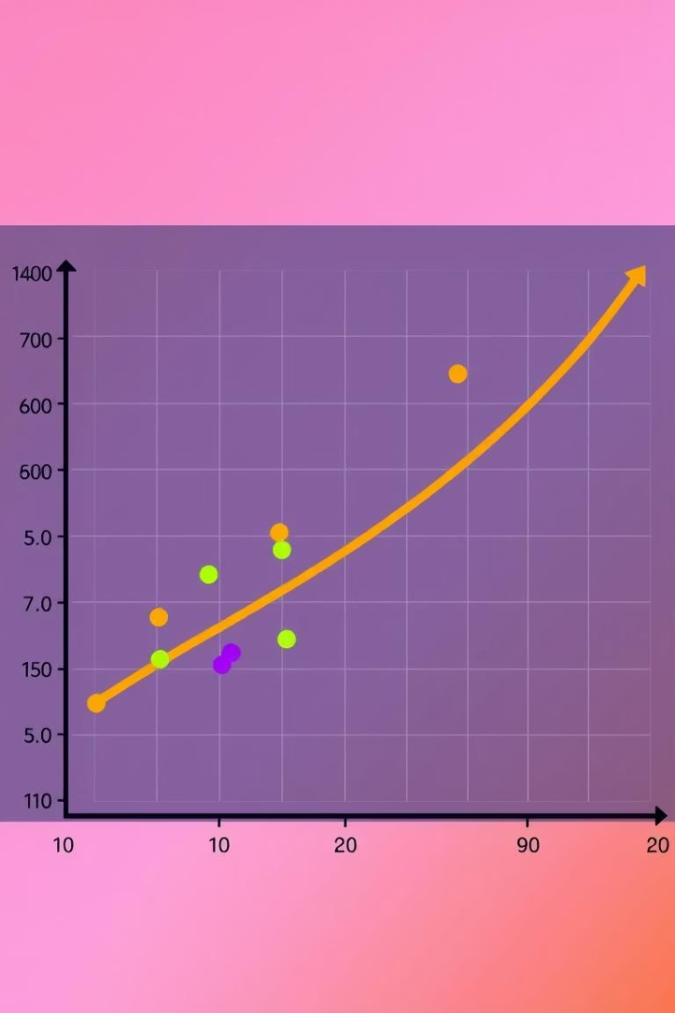
Statistical Validation Insights
Chi-Square Test
Results
Measures deviation from expected digit distribution.
High conformity observed with Benford’s Law in dataset.
Minor Variations
Attributed to data scale and rounding approximations.

Slide 7



Conclusions on Benford’s Law
2
Practical Use
Validates use in data integrity checks and fraud detection.
Dataset Compliance
Crude oil data strongly follows Benford’s distribution pattern.
1
Industry Relevance
Reveals order even in volatile industrial datasets.
3

Slide 8
Team Contributions
Himanshu Mishra
Harsh Patel
Krish Modi
Hirdyansh Kumar
Took the lead in understanding and applying Benford’s Law to real-world numerical data
Responsible for data cleaning and preprocessing of the crude oil dataset
Created all statistical plots: bar graphs for digit distribution and comparison
Designed and structured the presentation flow
Wrote clean, audience-friendly slide content
Ensured consistency in numeric formats across large data entries
Verified the frequency match against the theoretical Benford curve
Handled aesthetics, formatting, and documentation for submission
Performed data digit extraction, wrote custom logic for first-digit isolation
Collaborated on formatting the dataset for digit extraction
Worked on visual styling and data-labeling of charts for clarity
Coordinated the overall project workflow and ensured milestone completion

Slide 9

Thank You
Thank you for your attention!
We welcome your questions and feedback.

